Slide 1
521157A – Introduction to Social Network Seminar
Crime Network Analysis
Giuseppe Superbo
Nicola Zotto
Xiaowen Wang

Slide 2
Background

Slide 3
Dataset
(Oversize Network: https://figshare.com/articles/Oversize_network/3156067)
The zip file contains three networks (adjacency matrices -- binary unweighted -- in CSV format) describing the criminal organization targeted by operation Oversize (2000-2009), an Italian criminal case against a mafia group.
netWR.csv: Wiretap Records
netAW.csv: Arrest Warrant
netJU.csv: Judgement
Tools
Python 3.7
Networkx 2.0

Slide 4

An edge between two nodes is established whenever there is at least one telephone call between the two individuals.

Slide 5
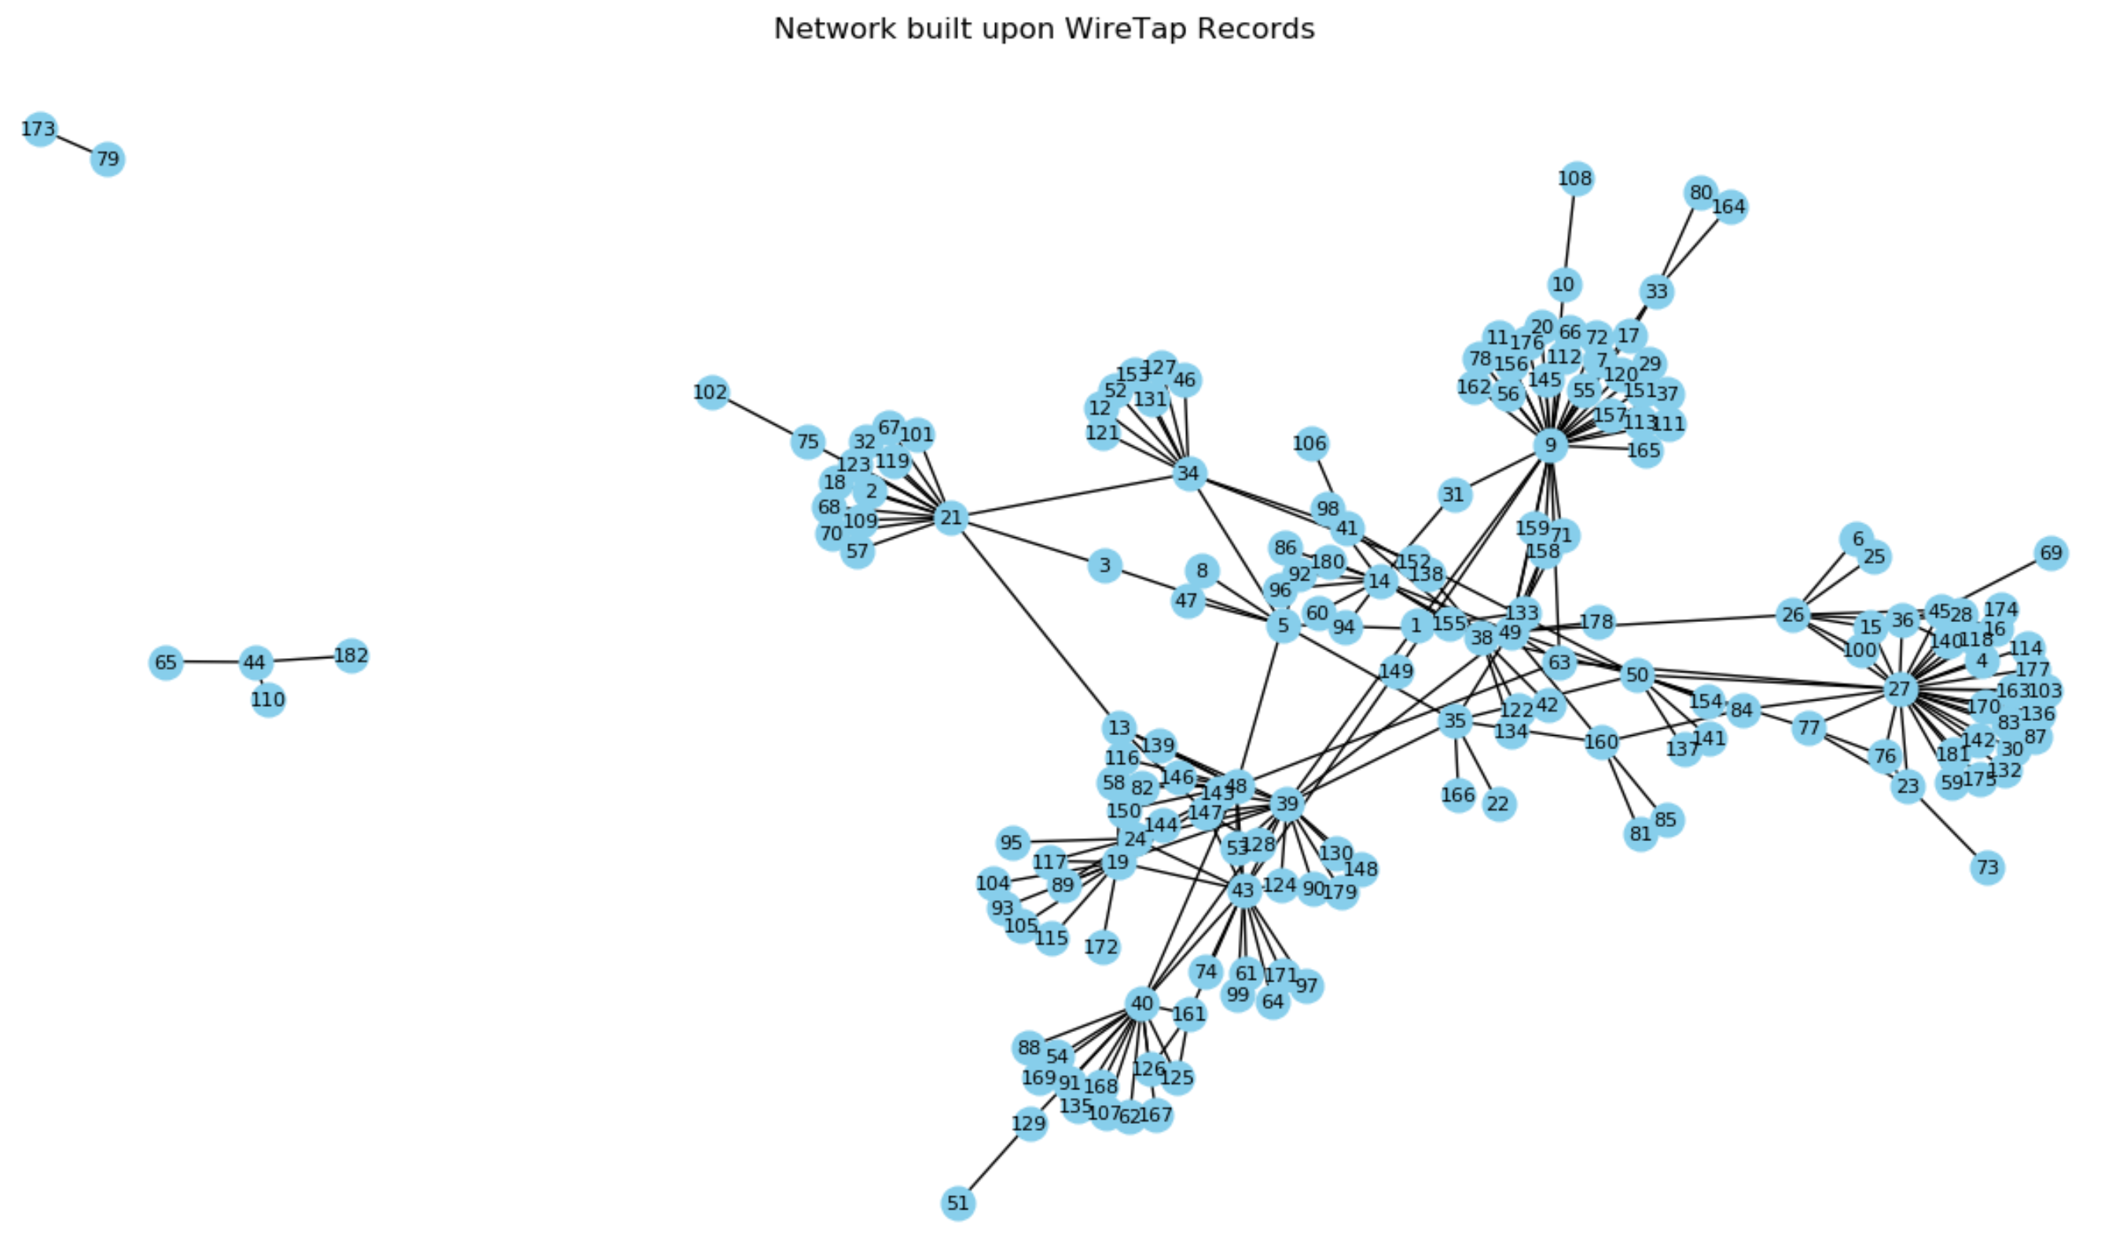
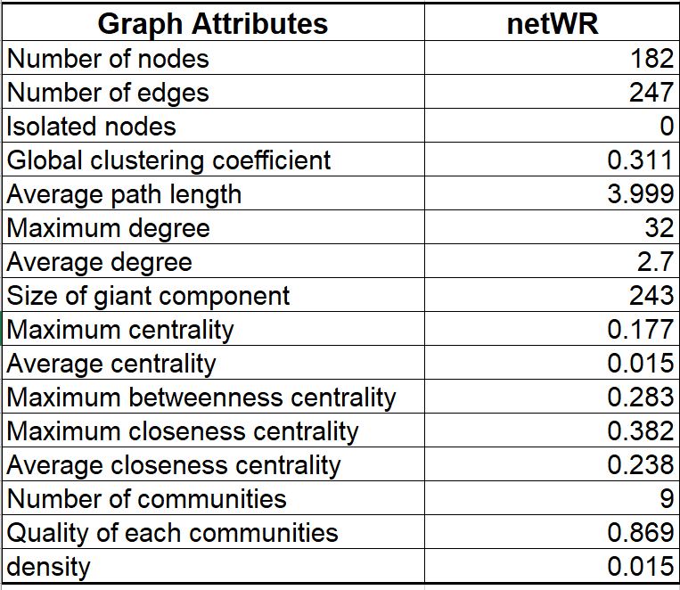
netWR - Original

Slide 6

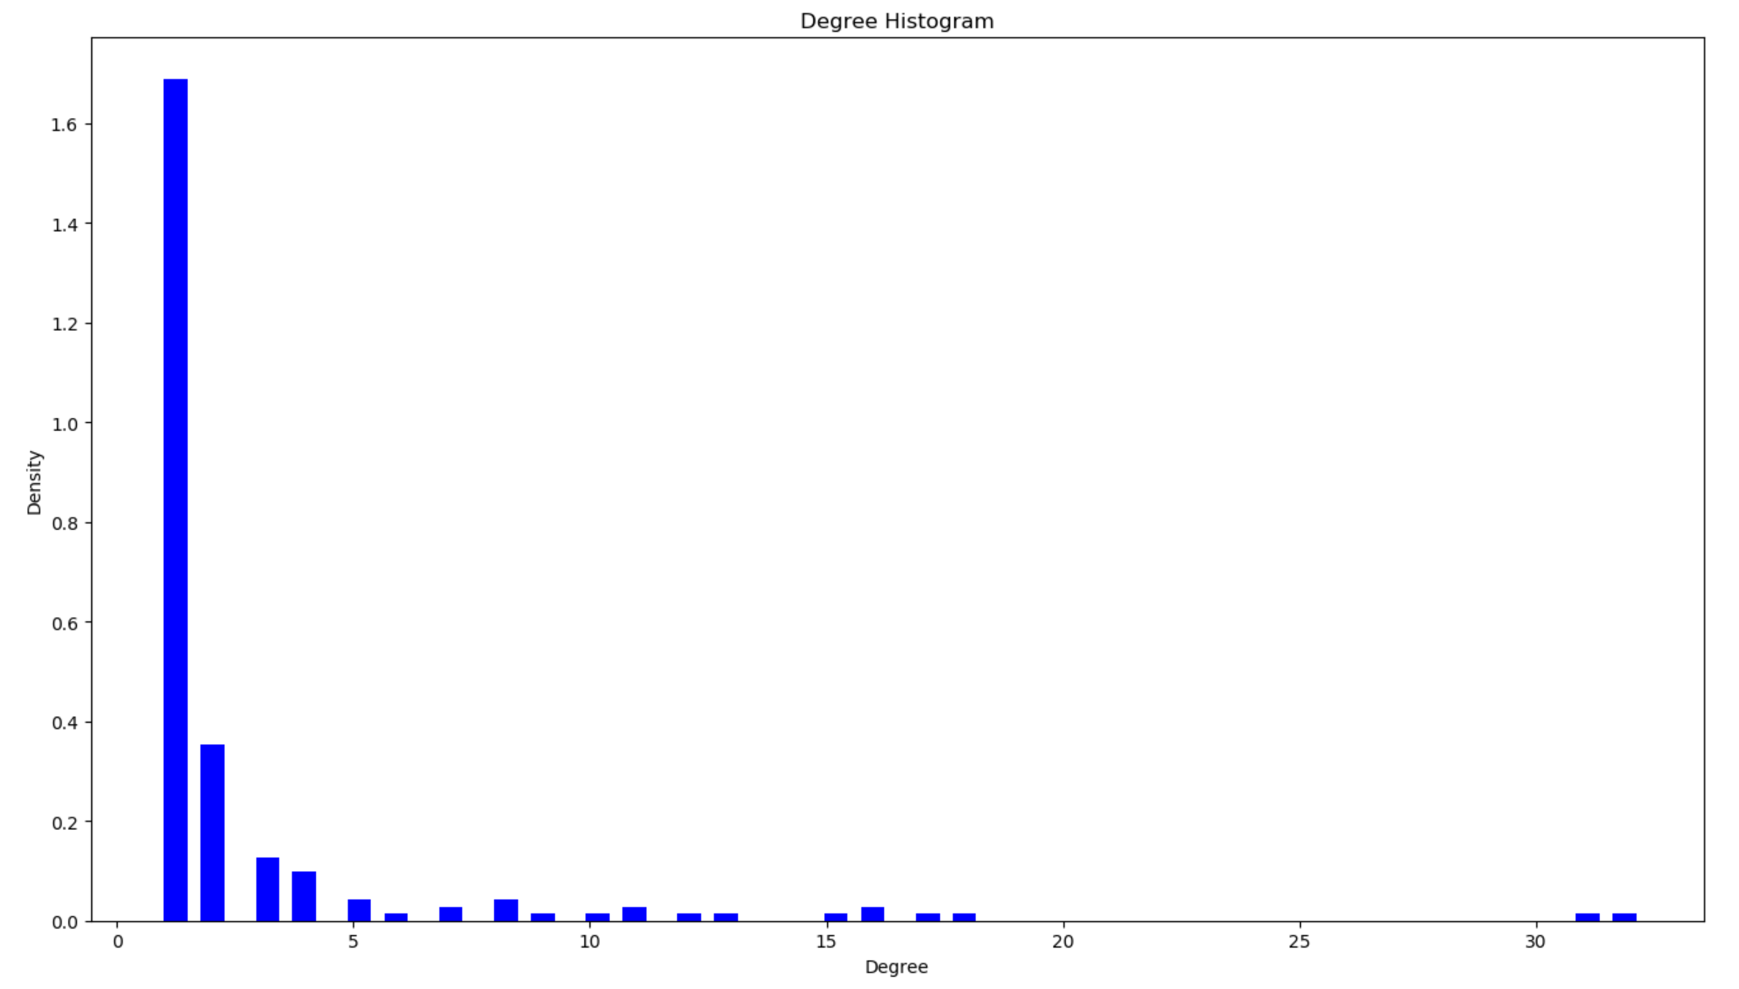
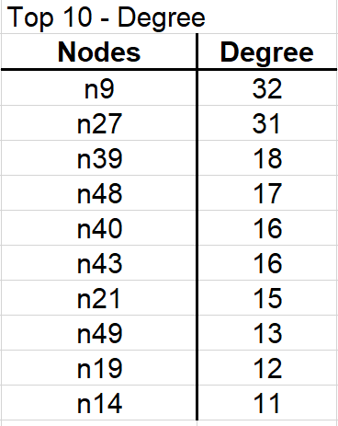
Importance of network members
Indicator 1 - Degree
Mean = 32
Max = 2.71
stDev = 4.42

Slide 7

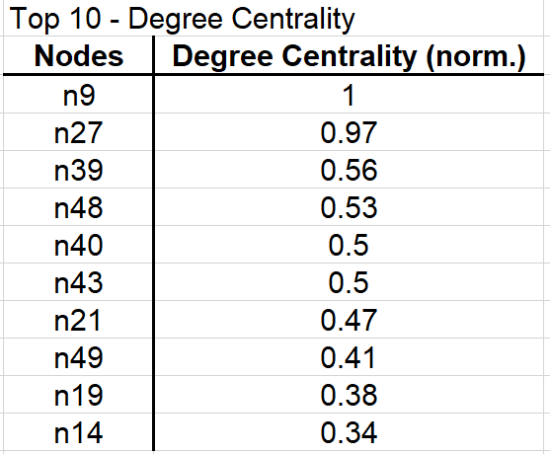
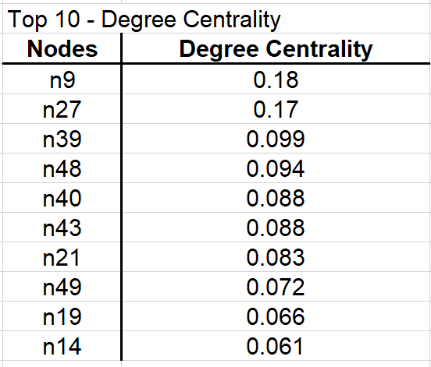
Count how many neighbours a node has.
Indicator 2 – Degree Centrality
Mean = 0.015
Max = 0.18
stDev = 0.024

Slide 8
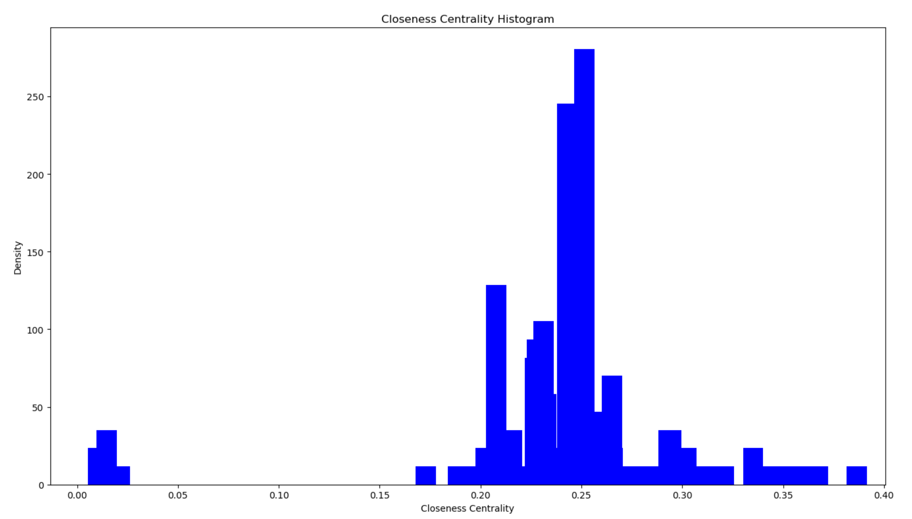
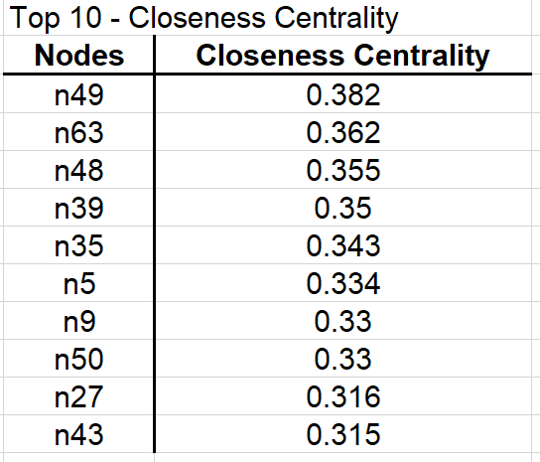
Indicator 3 – Closeness Centrality
How isloated members are?
Mean = 0.24
Max = 0.38
stDev = 0.054

Slide 9
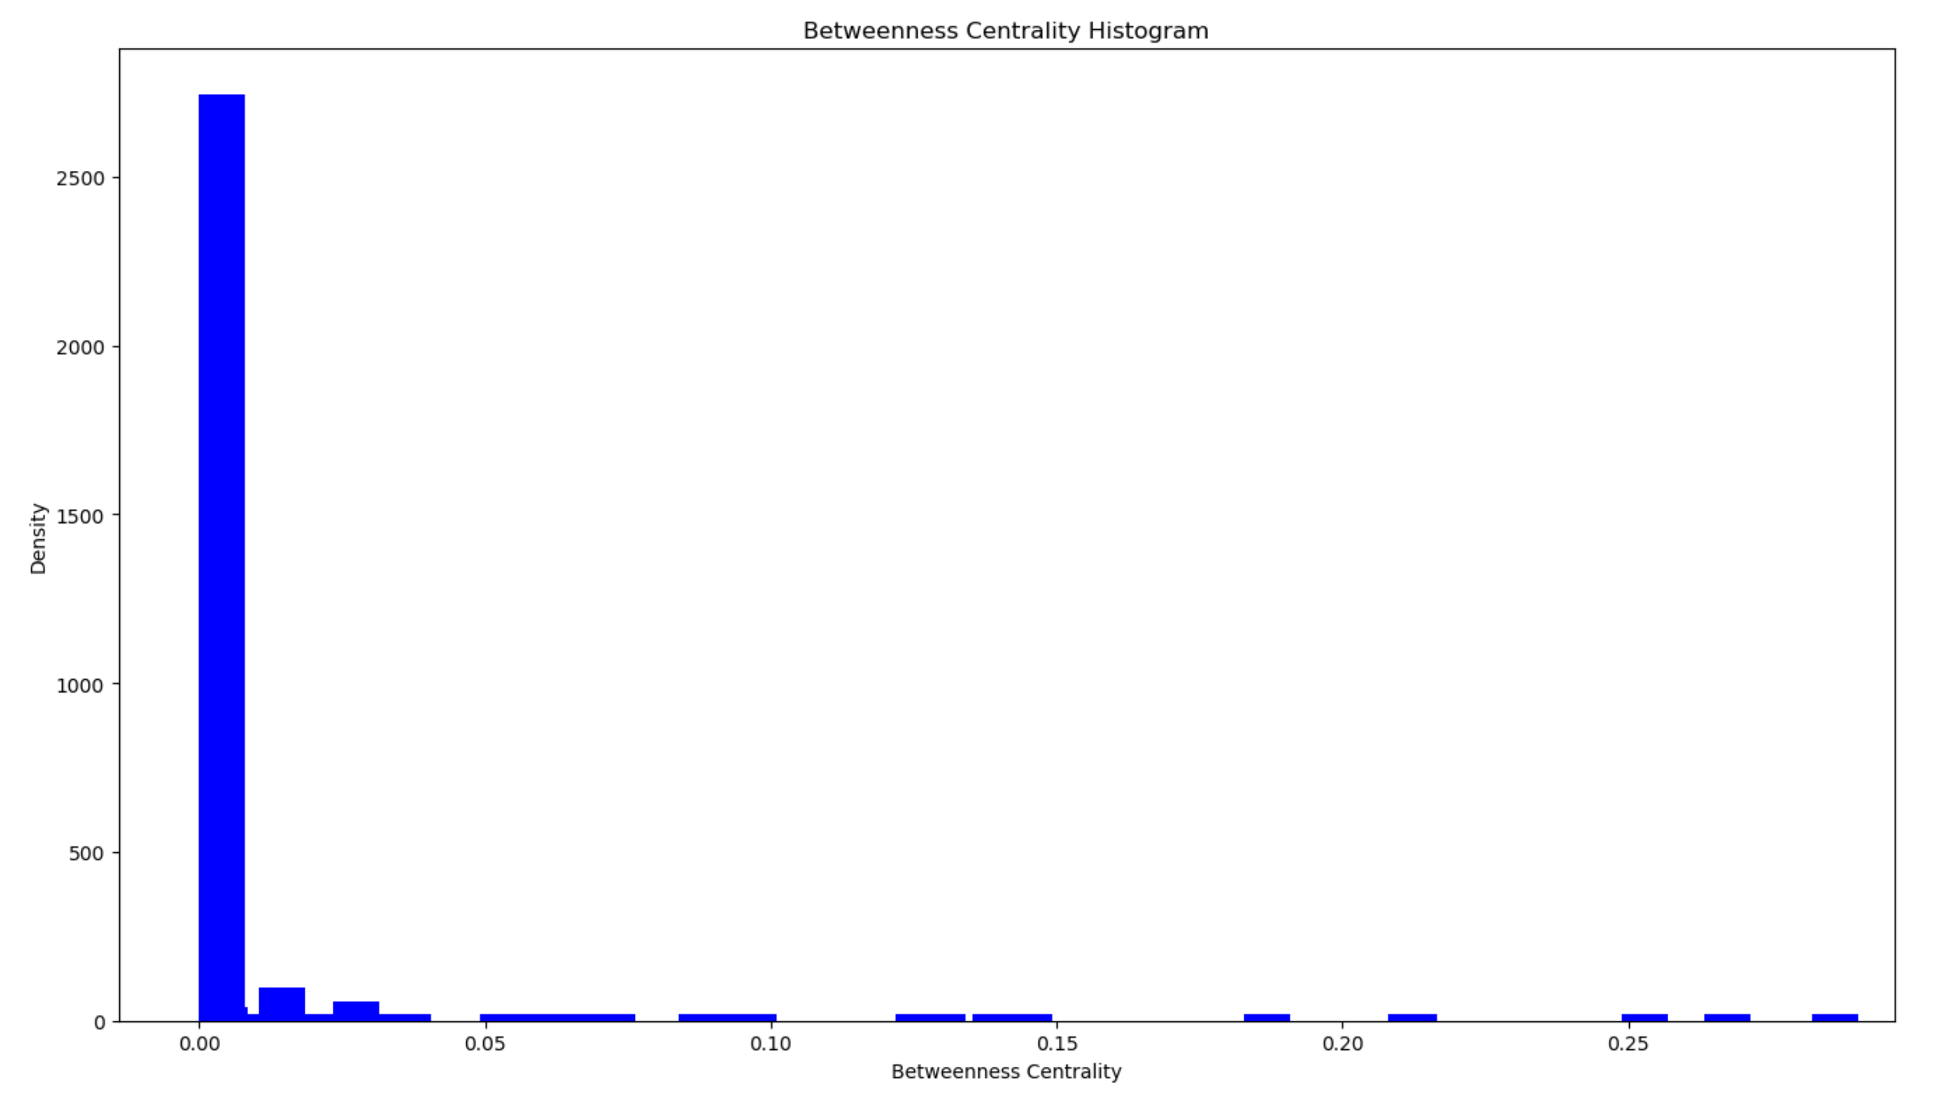
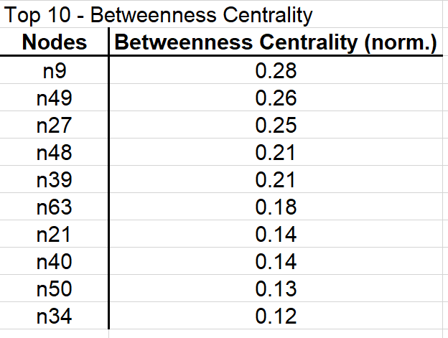
Measure the member’s capacity to act like a bridge between clusters of members!
Indicator 4 – Betweenness Centrality
Mean = 0.016
Max = 0.28
stDev = 0.048

Slide 10
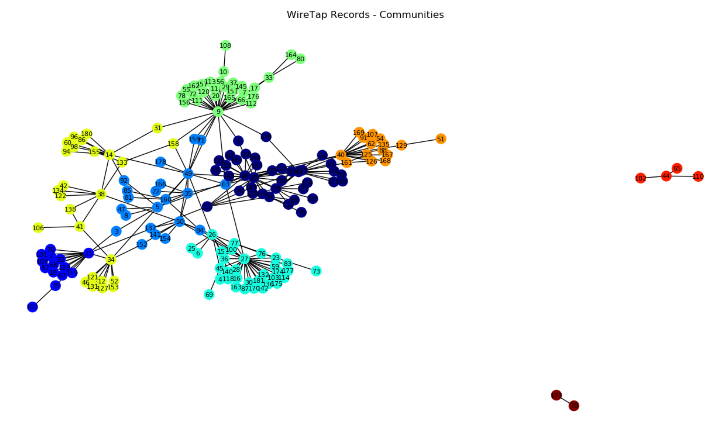
Communities Detection
Algorithm – Louvain algorithm
Communities - 9

Slide 11
What We Got…important nodes!
Top 5:
N9
N27
N49
N48
N39

Slide 12
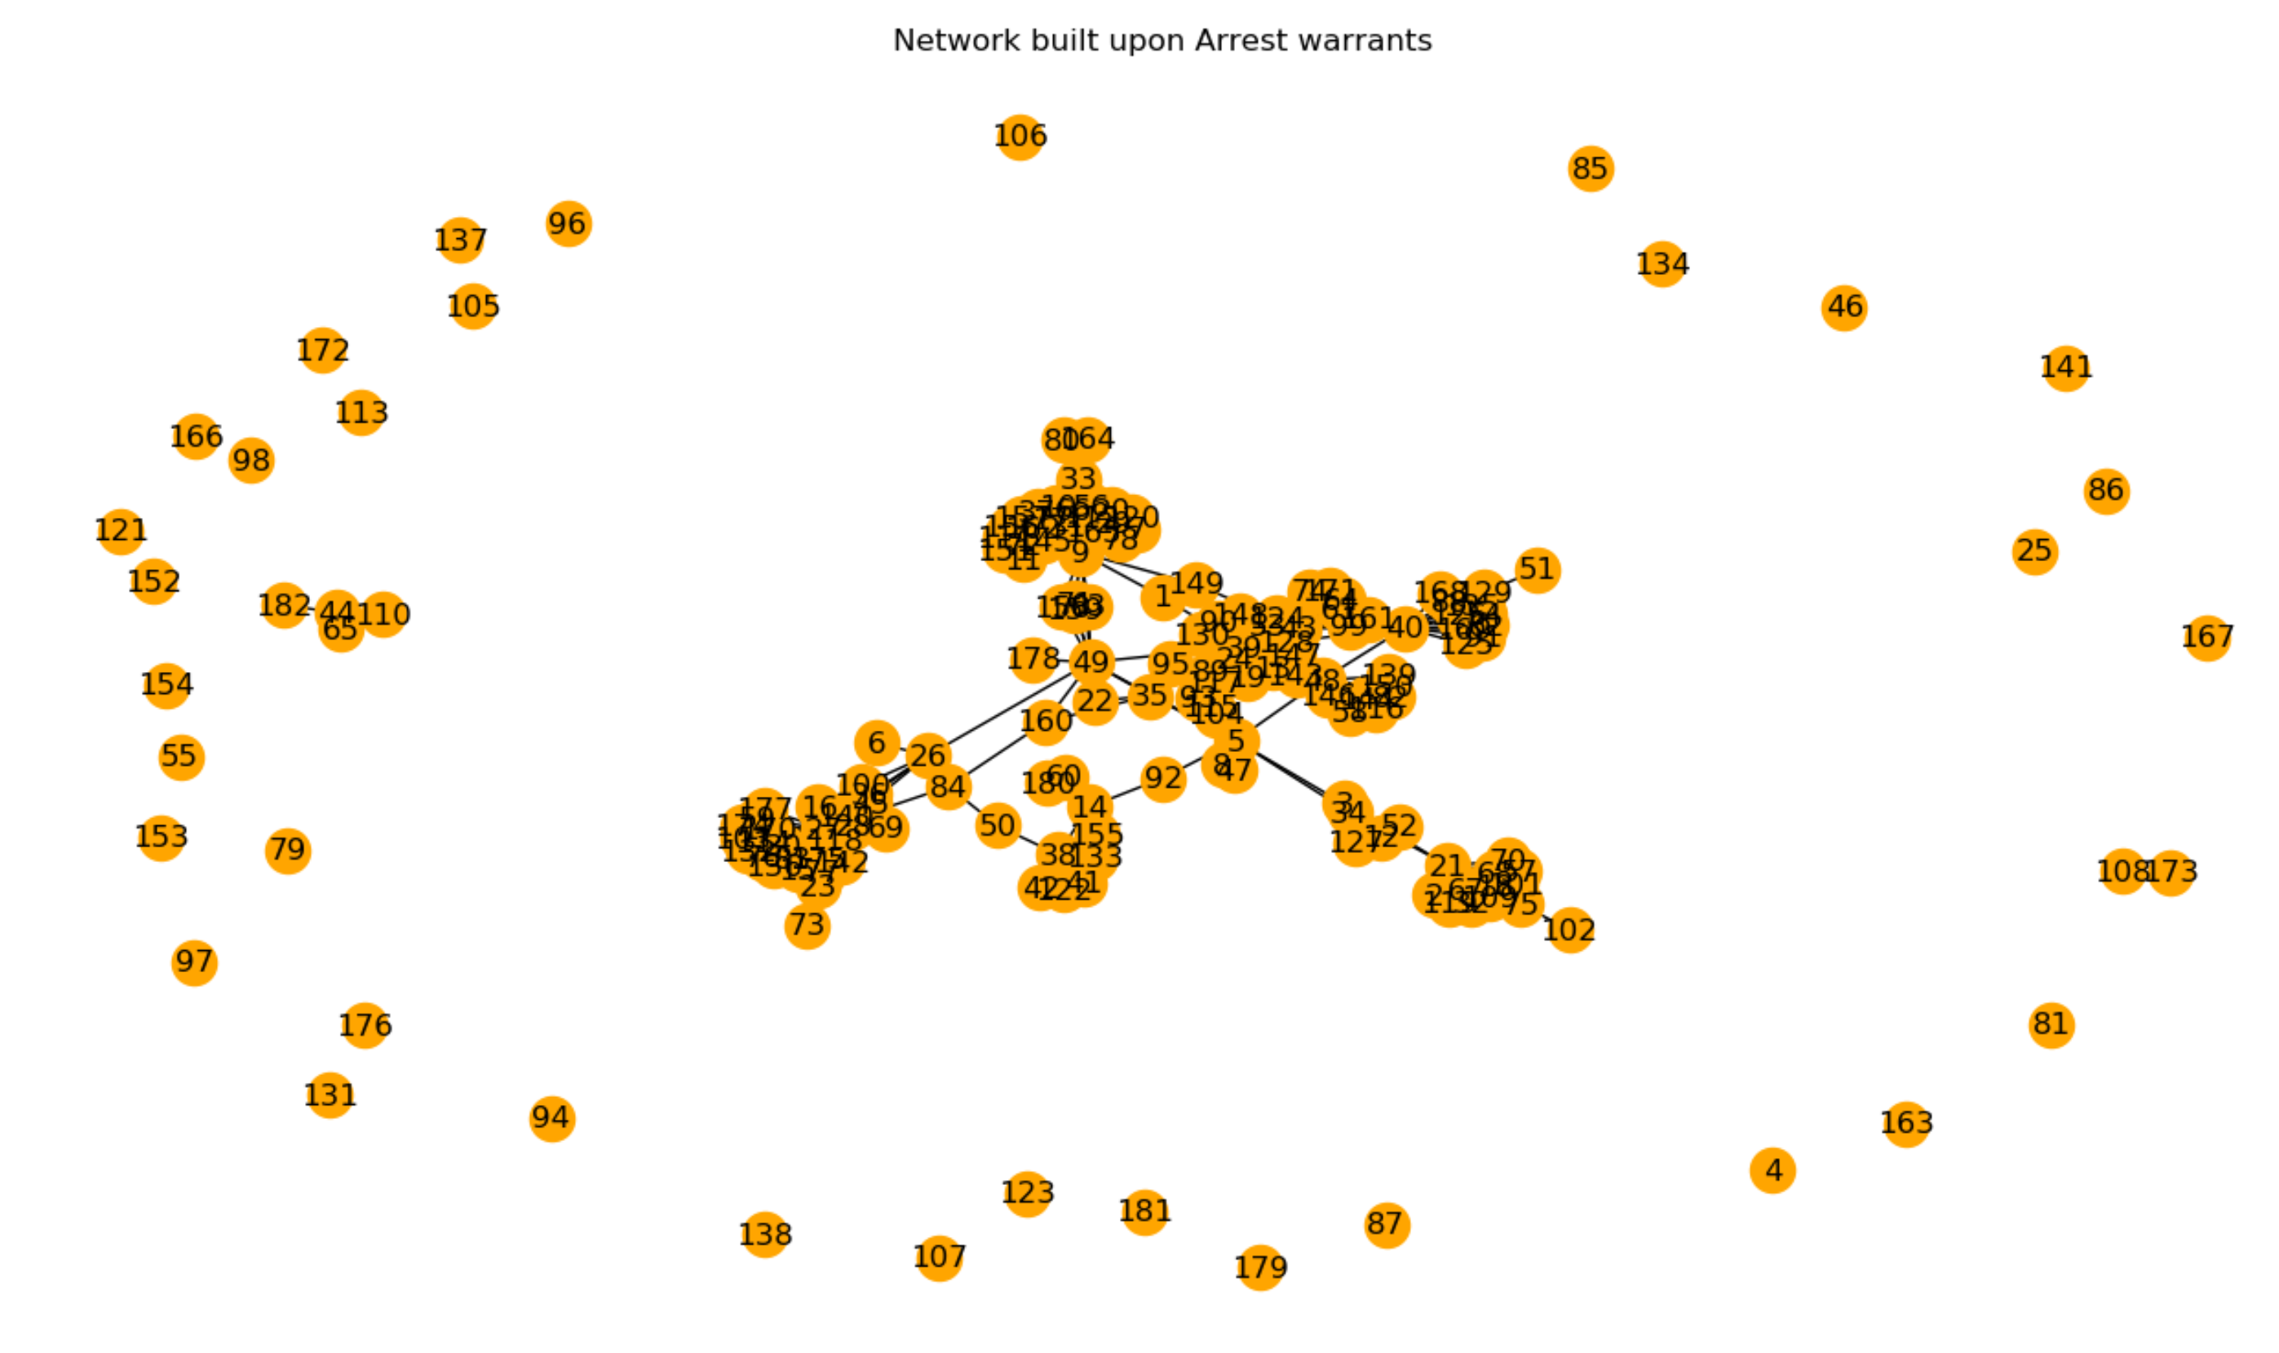
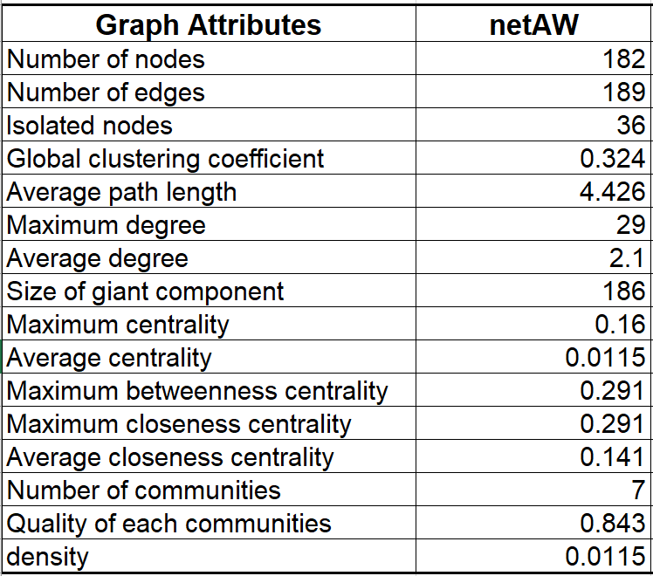
netAW - Original
From netWR:
58 edges were removed to create 36 isolated nodes.

Slide 13
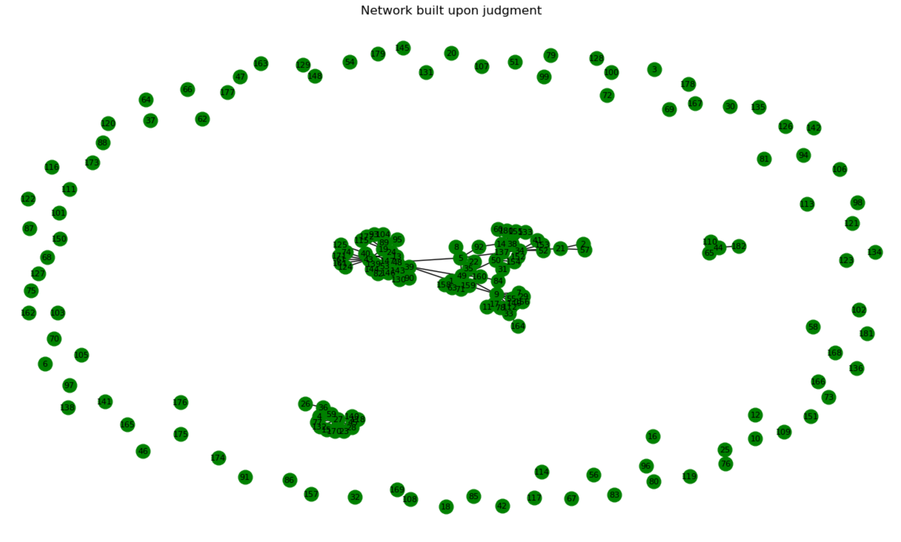
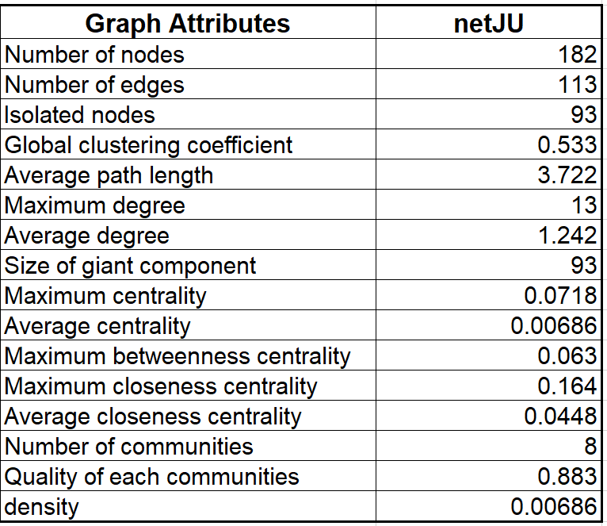
netJU - Original
From netWR:
134 edges were removed to create 93 isolated nodes.

Slide 14
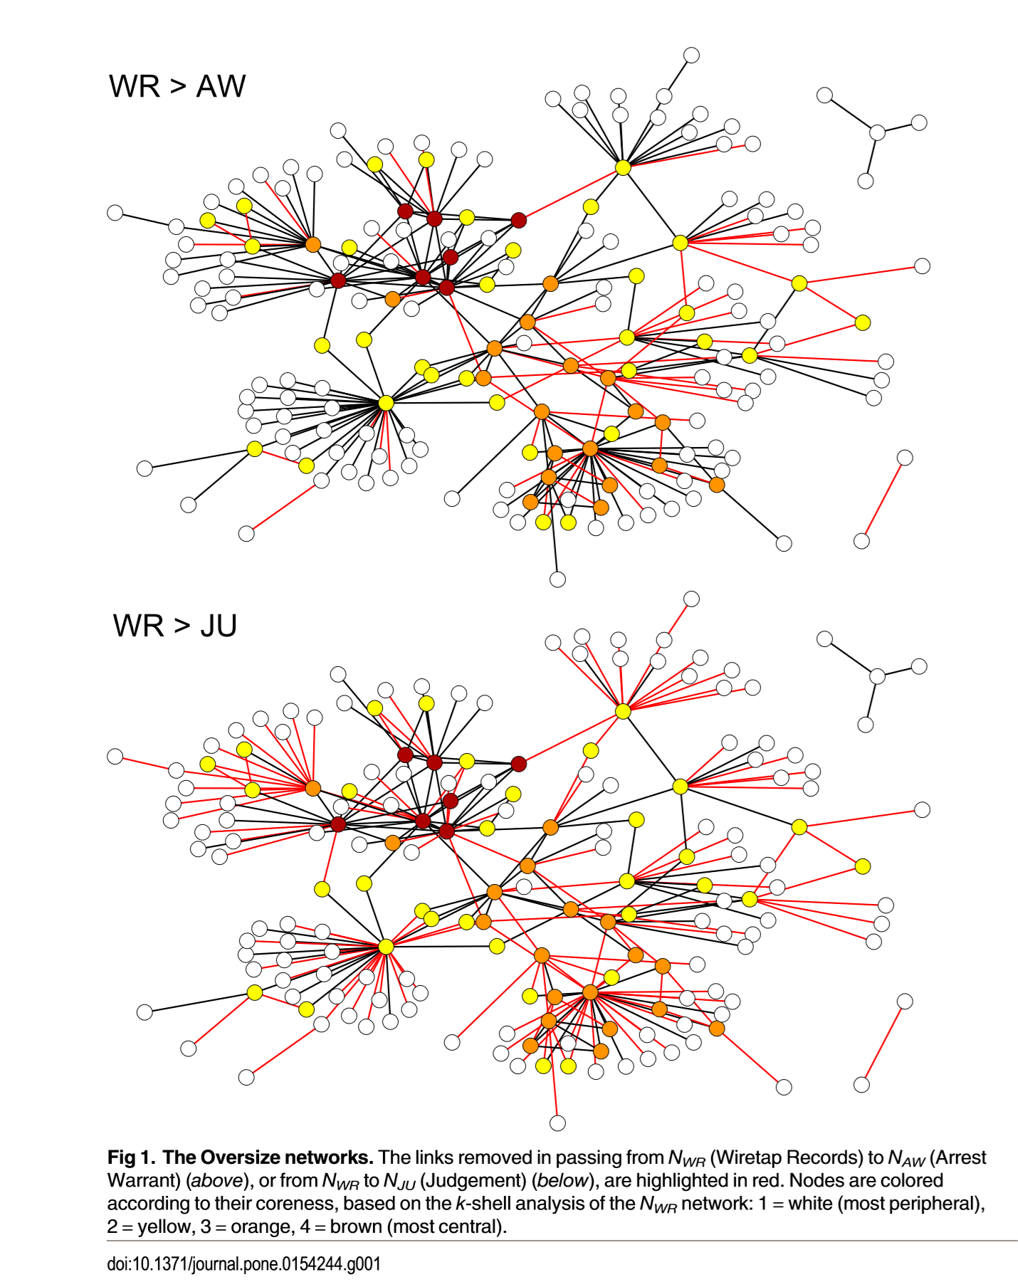

Slide 15
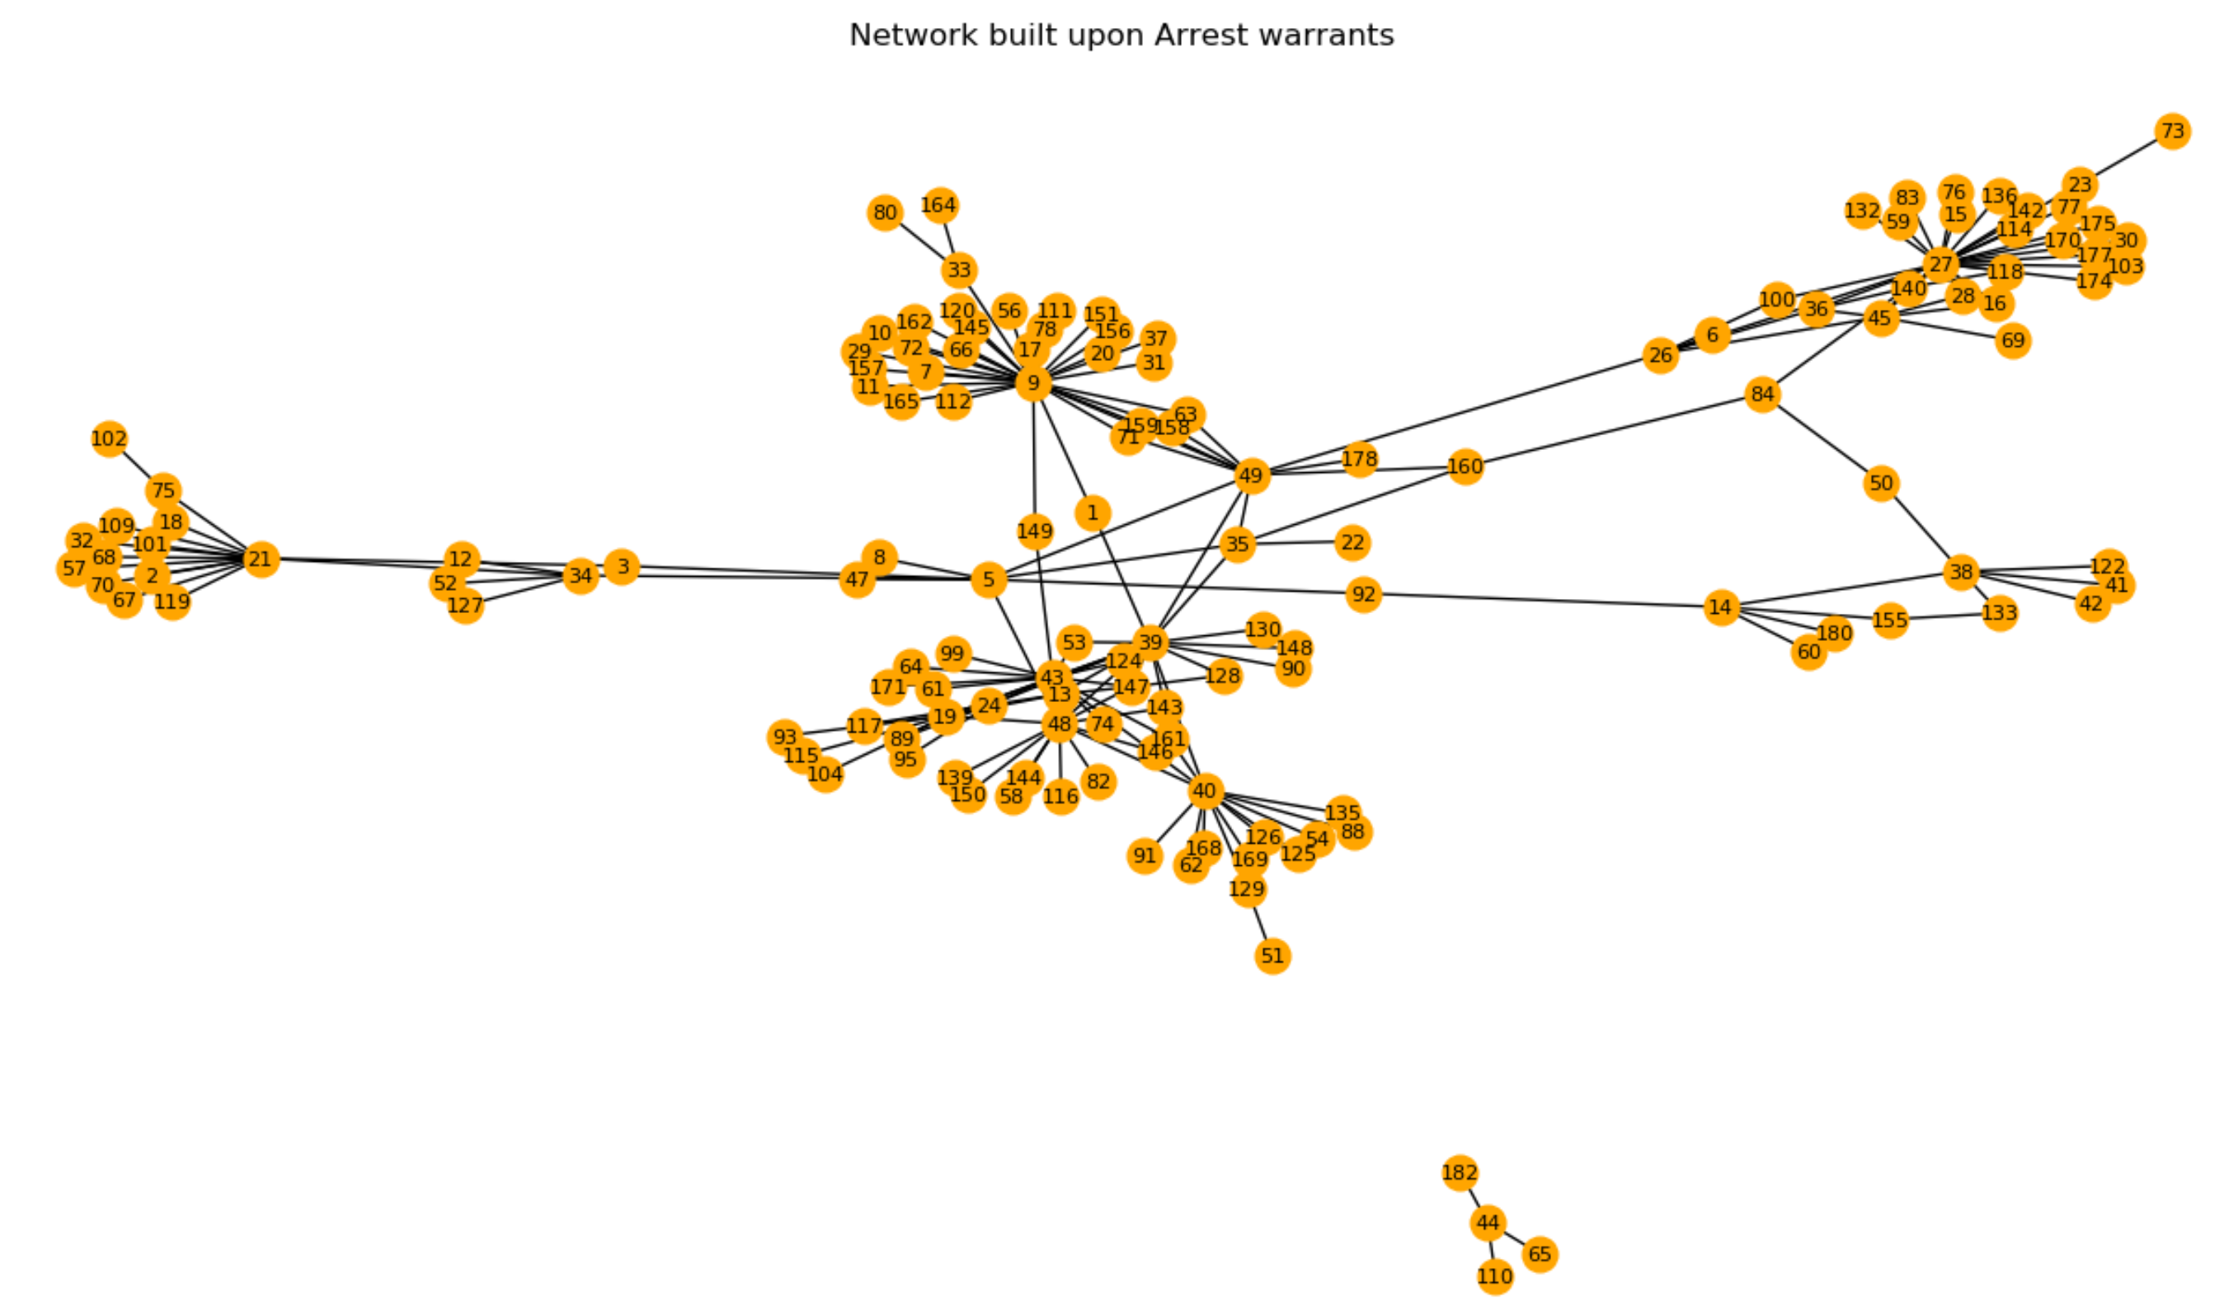
netAW - Isolated nodes removed

Slide 16
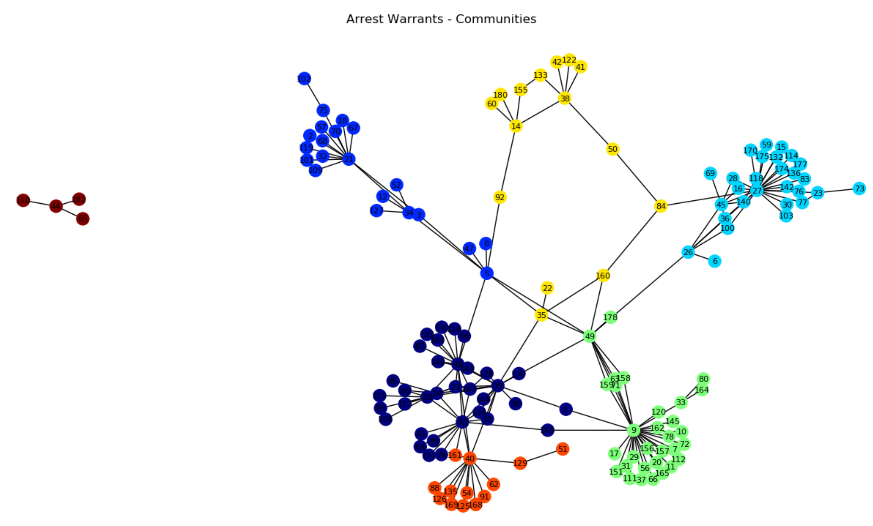
Communities Detection
Algorithm – Louvain algorithm
Communities - 7

Slide 17
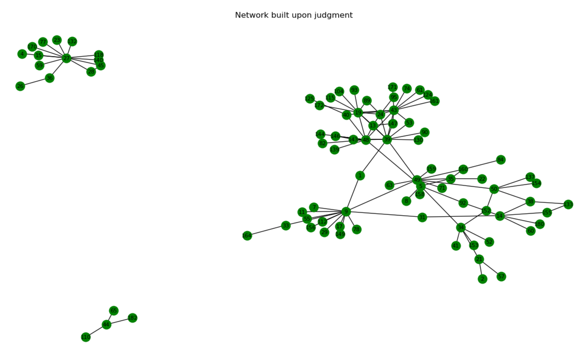
netJU - Isolated nodes removed

Slide 18
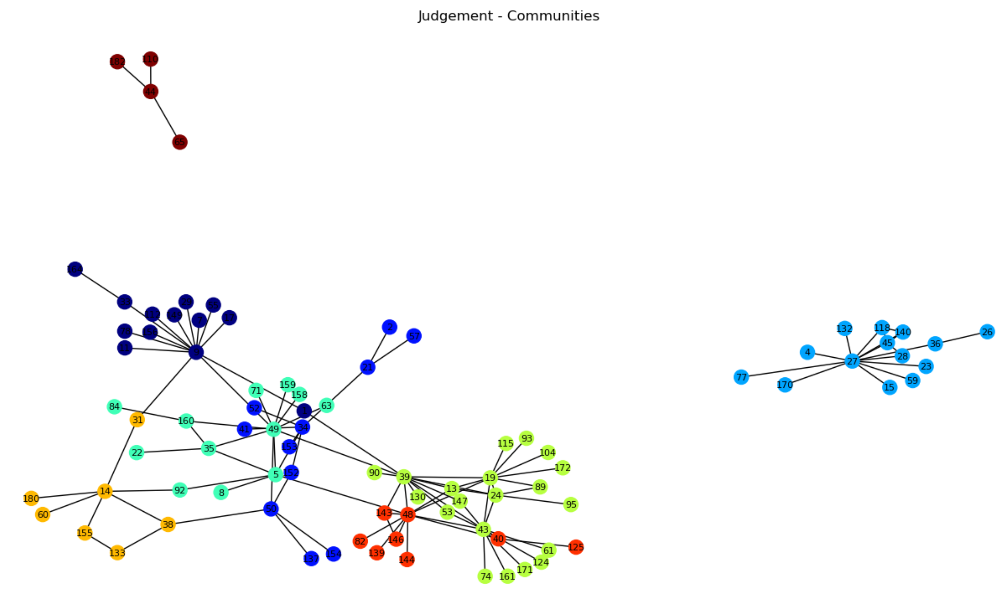
Communities Detection
Algorithm – Louvain algorithm
Communities - 8

Slide 19
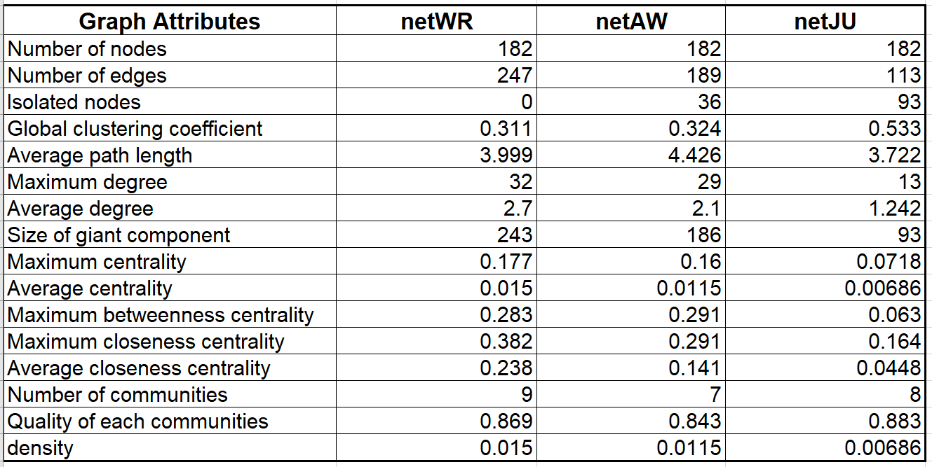
Summary
Graph attributes of three networks

Slide 20
"An edge between two nodes is established only if the number of phone calls between the two nodes is beyond a threshold k."
We created a 'Random Weighted Graph Generator' that generates a graph with weights between 1 and 40 from an adjacency matrix.
Draw plots showing the evolution with respect to k of:
The global clustering coefficient
The difference between maximum centrality and average centrality
The difference between maximum betweenness centrality and average betweenness centrality
The number of communities detected
The quality of the detected communities

Slide 21
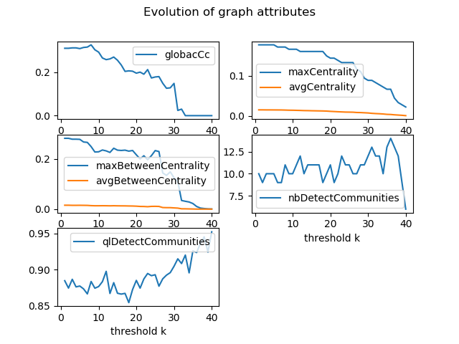
"Arrest Warrant" graph

Slide 22
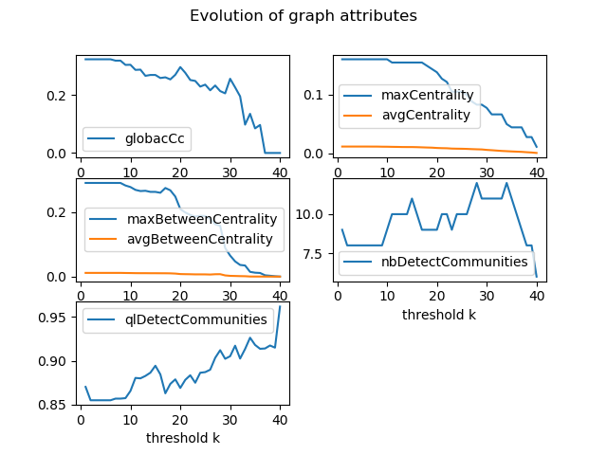
"W​iretap Records" graph

Slide 23
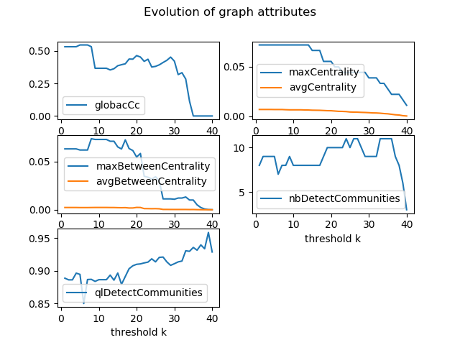
"Judgement" graph

Slide 24
We would like to investigate the consistency between the three networks as a way to construct a new edge allocation mechanism.
we assume that there is an edge between nodes A and B if the number of calls between A and B has shown important change between two Networks.

Slide 25
netWR < ------------ >netAW
need add
-new graph
-new graph attributes

Slide 26
netWR < ------------ >netJU
need add
-new graph
-new graph attributes

Slide 27
netAW < ------------ >netJU
need add
-new graph
-new graph attributes

Slide 28
We would like to simulate a random network whose clustering coefficient, diameter, maximum density, average density are as close as possible to that obtained in question 1 for each of the three networks.

Slide 29
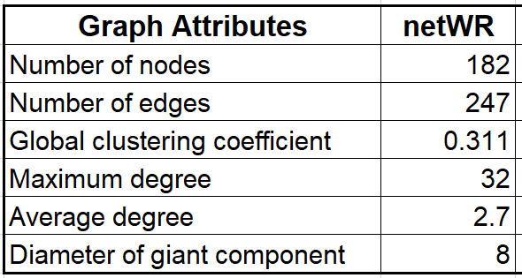
netWR - Original
Target

Slide 30
netWR Simulation
need add
-simulated graph
-simulated graph attributes
-similarity measurement

Slide 31
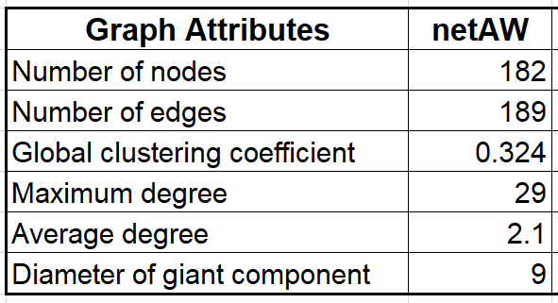
netAW - Original
Target

Slide 32
netAW Simulation
need add
-simulated graph
-simulated graph attributes
-similarity measurement

Slide 33
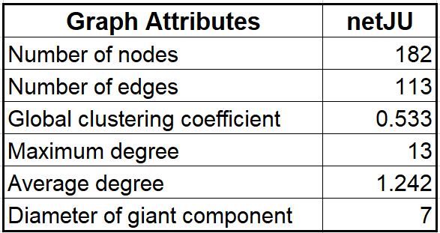
netAW - Original
Target

Slide 34
netJU Simulation
need add
-simulated graph
-simulated graph attributes
-similarity measurement

Slide 35
Deliveries
GUI
Github

Slide 36
References
[1] Berlusconi, G., Calderoni, F., Parolini, N., Verani, M., & Piccardi, C. (2016). Link prediction in criminal networks: A tool for criminal intelligence analysis. PloS one, 11(4), e0154244.
[2] Mastrobuoni, G., & Patacchini, E. (2012). Organized crime networks: An application of network analysis techniques to the American mafia. Review of Network Economics, 11(3).

Slide 37

Thanks for your attention!

